Slide 1

Heart Disease Prediction using Logistic Regression
Developing a machine learning model to predict the 10-year risk of Coronary Heart Disease (CHD) based on patient health metrics.
SUBMITTED BY
Shati Biswas

Slide 2
Problem Statement
Heart disease remains one of the leading causes of death globally.
Early detection is essential for timely treatment and improving patient survival rates.
However, predicting the 10-year risk of Coronary Heart Disease (CHD) based on clinical and lifestyle factors remains a challenging task.
Aim:
This project aims to leverage machine learning — specifically, logistic regression — to build a predictive model that assists healthcare professionals in assessing a patient's likelihood of developing CHD.

Slide 3





Project Overview
Objective
Data & Libraries
Predict 10-year CHD risk using Logistic Regression.
Import necessary libraries and the Framingham Heart Study dataset.
Analysis
Model Training
Perform Exploratory Data Analysis (EDA) and preprocessing.
Train and evaluate models, including hyperparameter tuning.

Slide 4
Dataset Insights
Name: Framingham Heart Study Dataset
Source: Likely derived from the Framingham Heart Study
Features include:
Age, Gender, Smoking status
Systolic and Diastolic Blood Pressure
Total Cholesterol, Glucose, BMI
History of stroke, hypertension, diabetes
Target variable: TenYearCHD (0 or 1)

Slide 5

Data Preparation & Preprocessing
Initial Steps
Preprocessing
Load Framingham dataset.
Drop rows with missing values.
Drop 'education' column.
Normalize numerical features using StandardScaler.
Rename columns for clarity (e.g., 'male' to 'is_male').
Split data into training (70%) and testing (30%) sets.

Slide 6
Exploratory Data Analysis (EDA)
The correlation heatmap reveals key relationships between features:
Age & Blood Pressure
Smoking Habits
Strong positive correlation between age and both systolic and diastolic blood pressure.
High positive correlation between being a smoker and cigarettes per day.
Predictive Features
Gender & Risk
Age, sysBP, diaBP, and glucose show positive correlation with TenYearCHD.
Negative correlation with 'is_male' suggests females may have higher risk in this dataset.

Slide 7
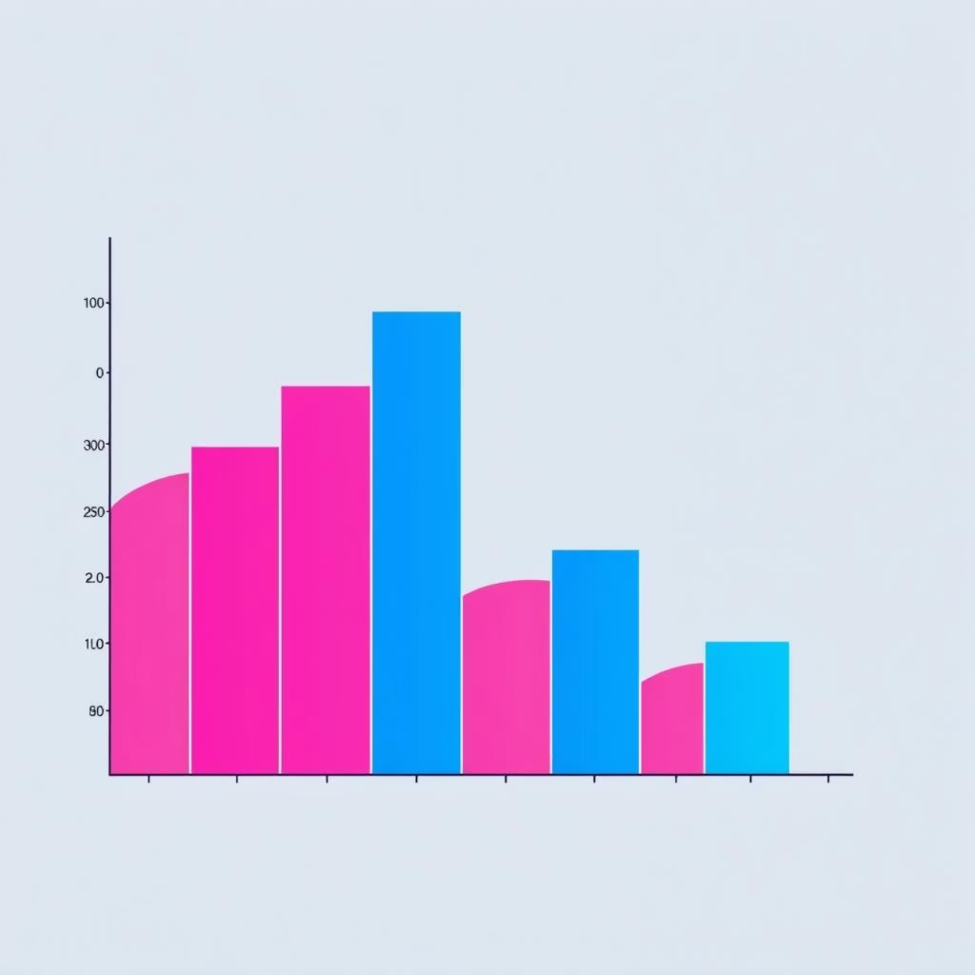
Addressing Class Imbalance with SMOTE
The Challenge
Our Solution: SMOTE
The dataset exhibits a significant class imbalance, with many more instances of no CHD than CHD.
To address this, we applied SMOTE (Synthetic Minority Over-sampling Technique) to the training data to oversample the minority class.
SMOTE helps create a more balanced dataset, improving model performance for the minority class.

Slide 8
Initial Model Training & Evaluation
We trained an initial Logistic Regression model using the balanced training data.
Initial Logistic Regression
0.682
0.293
0.638
0.401
0.709
The initial model shows a reasonable ROC AUC, but there's room for improvement, especially in precision.

Slide 9
Model Improvement: GridSearchCV
To enhance the model's performance, we utilized GridSearchCV for hyperparameter tuning on the Logistic Regression model.
1
2
3
Define Grid
Create GridSearchCV
Fit & Evaluate
Set parameter grid for 'C', 'penalty', and 'solver'.
Configure with 5-fold cross-validation, optimizing for 'recall'.
Fit to resampled data to find the best parameters and model.
Best Parameters: {'C': 0.01, 'penalty': 'l1', 'solver': 'liblinear'}
Best Recall Score: 0.732

Slide 10
Best Model Evaluation
The hyperparameter-tuned Logistic Regression model demonstrates improved recall, crucial for identifying positive CHD cases.
Best Logistic Regression
0.645
0.273
0.676
0.388
0.714

Slide 11
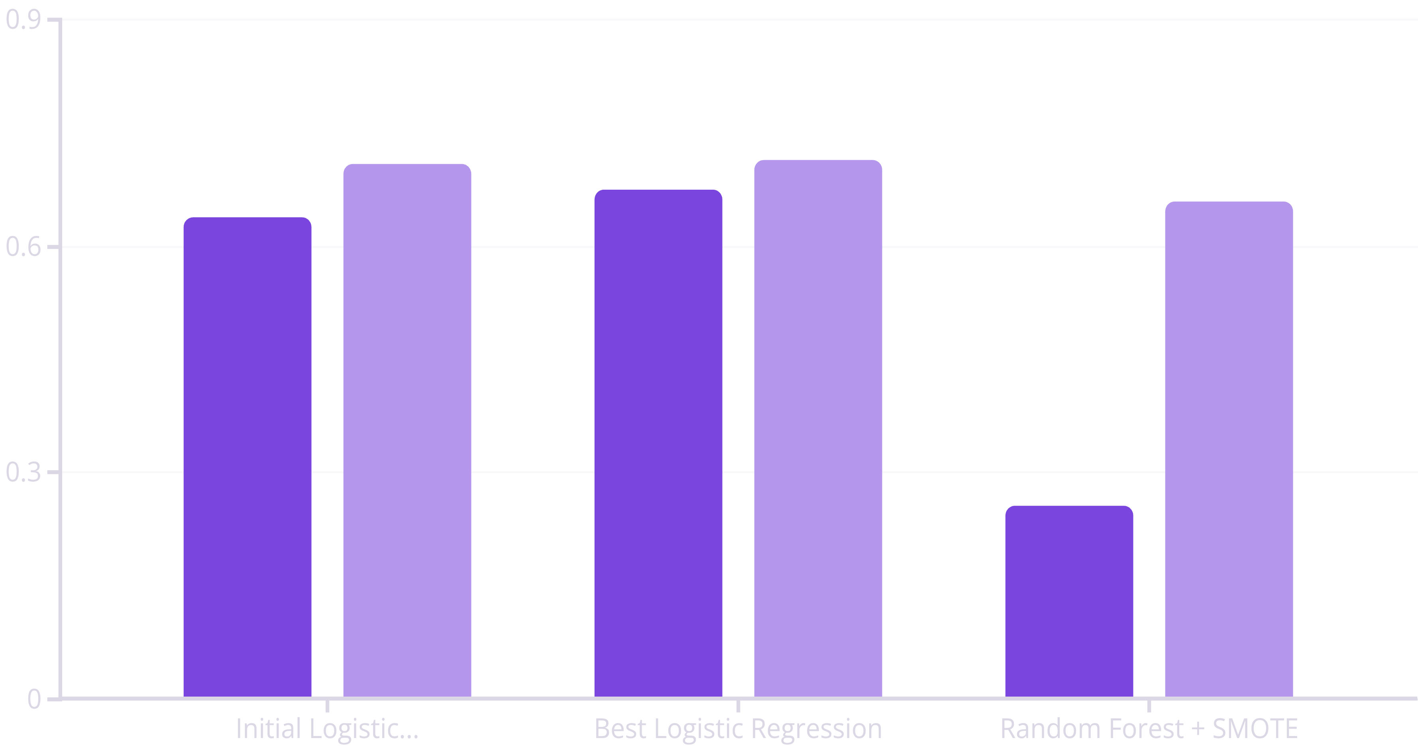
Model Comparison & Key Finding
Recall
ROC AUC
The Best Logistic Regression Model achieved the highest recall (0.676) and ROC AUC (0.714), making it most suitable for identifying positive CHD cases, despite Random Forest's higher accuracy.

Slide 12
Challenges
Missing Data: Some rows contain NaN values, requiring preprocessing.
Class Imbalance: Fewer positive CHD cases than negative ones.
Feature Scaling: Necessary for logistic regression to perform well.
Interpretability vs Accuracy: Logistic regression is interpretable but may not capture non-linear patterns.
Model Generalization: Avoiding overfitting with a relatively small dataset.

Slide 13

Future Improvements
Algorithm Exploration
Resampling Techniques
Experiment with Decision Trees, Random Forests, Gradient Boosting Machines, and SVMs.
Explore Undersampling or combination methods (SMOTE-ENN, SMOTE-Tomek).
Data Collection
Feature Engineering
Consider collecting more data, especially for the minority class.
Create new features or modify existing ones based on domain knowledge.

Slide 14
THANK YOU

